Slide 1



Engineering Calculus (EMAT101L)

Slide 2
Course Details:
Course code: EMAT101L
Course name: Engineering Calculus
Course components:
L | T | P | Credits
3 | 1 | 0 | 4

Slide 3
Course content:
Module 1: 11 hours
The Real Number System, Archimedean Property, Convergence of a Sequence, Monotone Sequences, Cauchy Criterion, Bolzano-Weierstrass Theorem, Limit inferior and Limit Superior. Infinite Series, Convergence Tests including nth term test, Integral test, Comparison test, Ratio test, Root test, and Alternating series test.

Slide 4
Course content:
Module 2: 11 hours
Limit, Continuity, Existence of Maxima, Intermediate Value Property. Differentiability, Rolle’s Theorem, Mean Value Theorem. Convexity, Concavity, L’Hospital Rule, Fixed Point Iteration Method, Taylor’s Theorem, Taylor and Maclaurian Series, Power Series.

Slide 5
Course content:
Module 3: 11 hours
Riemann Integration, Advanced Integration Techniques (includes discussion of integration by parts, trigonometric integrals, trigonometric substitution, integration of rational functions using partial fraction decomposition), Fundamental Theorems of Calculus, Area between two curves; Polar Coordinates, Volumes by slicing, Washer and Shell Methods, Length of a plane curve, Areas of Surfaces of Revolution. Improper Integrals, Beta-Gamma Functions.

Slide 6
Course content: Module 4: 12 hours
Functions of Several Variables: limit, Continuity and Differentiability, Chain Rule, Directional Derivative, Gradient. Mixed Derivative Theorem, MVT, Extended MVT, Taylor’s Theorem in Multiple Variables, Hessian, Maxima, Minima, Second Derivative Test, Lagrange Multiplier Method. Double Integrals, Change of Variable in a Double and Triple Integrals, Area of a Parametric Surface and surface integral. Surface Area, Surface Integrals.

Slide 7
Text books:
Maurice D. Weir and Joel Hass, Thomas’ Calculus (14th ed.), Pearson Education India, 2018. ISBN 978-9353060411, ISBN 9789353060411.
K. A. Ross, Elementary Analysis: The Theory of Calculus (2nd ed.), Springer, 2013. ISBN 978-1493901289, ISBN 978-
1461462705.
Erwin Kreyszig, Advanced Engineering Mathematics (10th ed.), Wiley, 2010. ISBN 978-8126554232, ISBN 8126554231.

Slide 8
References:
S. R. Ghorpade and B. V. Limaye, A Course in Calculus and Real Analysis, Springer-Verlag New York, 2006. ISBN 978-0387305301, ISBN 0387305300.
James Stewart, Calculus (7 th ed.), Brooks Cole Cengage Learning, 2012. ISBN 9780538497817, ISBN 0538497815.
Robert G. Bartle and Donald R. Sherbert, Introduction to Real Analysis (4 th ed.), Wiley, 2014. ISBN 978-8126551811, ISBN 812655181X.

Slide 9
Evaluation Policy:
Components of course evaluation | Distribution percentage
Quiz | 10
Mid Term Examination | 20
Certification | 15
Continuous evaluation (Tutorial attendance + Submission) | 15
End term Evaluation | 40

Slide 10
Certification Link:
Machine Learning with MATLAB | Self-Paced Online Courses - MATLAB & Simulink
First Submission Dedline: 30 Sept, 2025 (15 Marks)
Second Submission Dedline: 15 Oct, 2025 (12 Marks)
Third Submission Dedline: 30 Oct, 2025 (10 Marks)
Fourth Submission Dedline: 5 Nov, 2025 (5 Marks)
Note:The certification completion date does not matter; only the submission date is important.

Slide 11
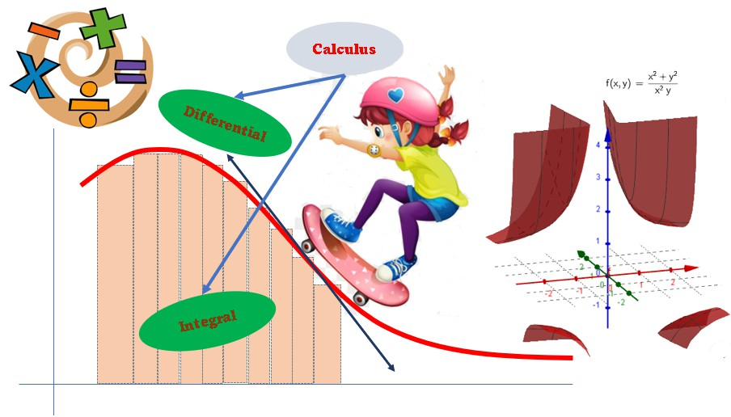

Slide 12

Game Programming
Calculus is often used in video games.

Slide 13
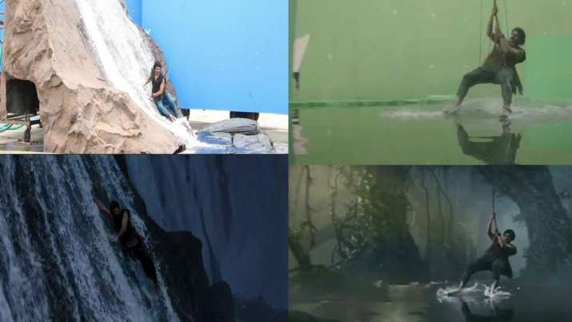
Visual Effect/VFX
Calculus in creating visual effects.

Slide 14
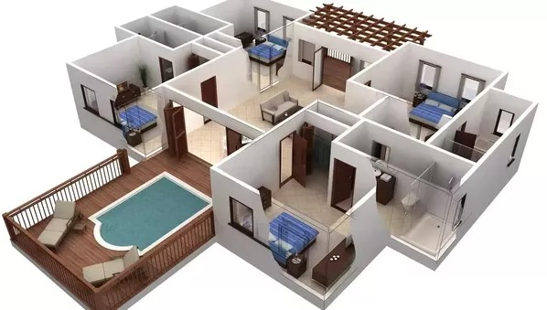
Architectural Use
Software Development
AutoCAD is a commercial computer-aided design and drafting software application.

Slide 15

Military Use
Software Development
Military uses visuals for simulations, flight, paths, navigation, maps, satellite images, etc.
Virtual reality (VR) often is used for military training.

Slide 16
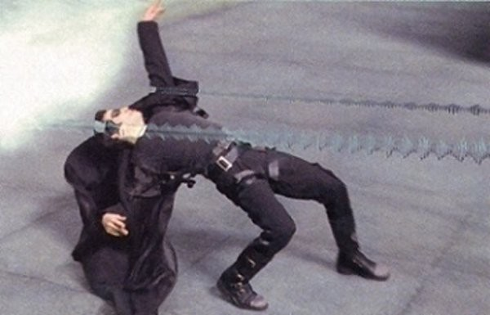
General Problem Solving
Calculus is used in general problem solving applications, simulations, and physics engines.

Slide 17
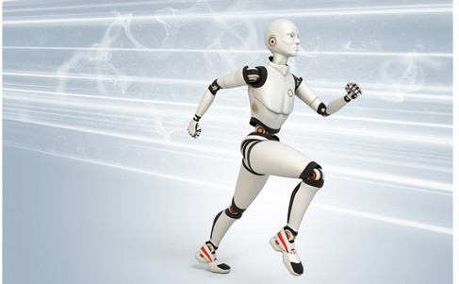
Robotics Use
In robotics, a programmer often needs to model physical movements of a robot, so he/she will need to know partial derivatives and gradients.

Slide 18
Further Uses
Calculus is used for optimization, summation, and predicting trends through modeling change over time.
For example, a manufacturer could use Calculus to optimize production costs.
Furthermore, Calculus is used to predict the weather patterns.

Slide 19

Thank you.

